Slide 1
Value of Information
ENERGY 160/260
Modeling Uncertainty in the Earth Sciences

Slide 2
Recall our case study from lecture 1
Decision to be made:
move certain farms (or not) to protect groundwater

Slide 3
Value of information
To determine the value of gathering data prior to actually gathering the data, this value will depend on
The particular decision problem at hand
The uncertainty prior to gathering the data
The reliability of the measurement device in resolving spatial variation or key geological drivers

Slide 4
Simple generic example
Decision to make about an opportunity, alternatives D₁ (go ahead) or D₂ (walk)
Uncertain event A, possibilities a₁ and a₂ influence outcome in case we decide to go ahead
Do we decide between D₁ and D₂ or do we take more data B, whose outcome is uncertain
Two possible outcomes for data: b₁ and b₂

Slide 5
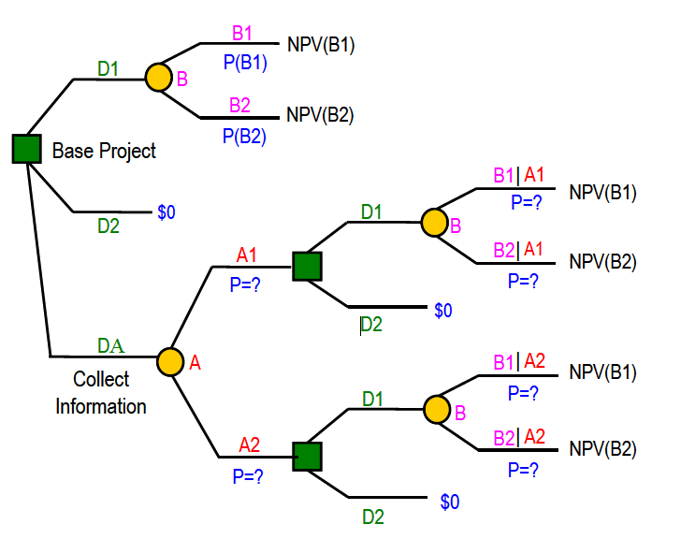
Decision tree
a1
NPV(a1)
P(A=a1)
A
a2
NPV(a2)
P(A=a2)
A1|B1
NPV(A1)
A
B1
A2|B1
NPV(A2)
B
A1|B2
NPV(A1)
A
B2
A2|B2
NPV(A2)

Slide 6
Decision tree with data
a1
NPV(a1)
P(A=a1)
A
a2
NPV(a2)
P(A=a2)
A=a1|b1
NPV(a1)
A
B=b1
A=a2|b1
NPV(a2)
B
A=a1|b2
NPV(a1)
A
B=b2
A=a2|b2
NPV(a2)

Slide 7
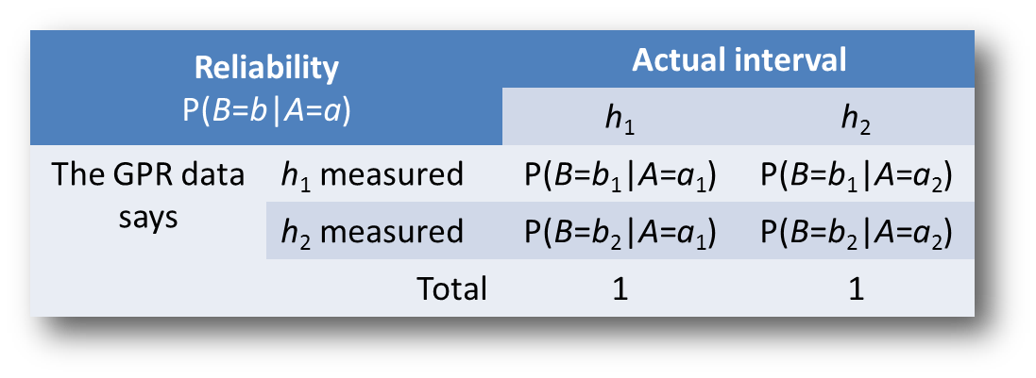
Data reliability
Important in determining VOI is determining how well
the data source B will resolve the uncertain event A
A reliability is modeled as a conditional distribution of the form
P(data says | what real world is)

Slide 8
Data reliability vs information content
A reliability is modeled as a conditional distribution of the form
P(data says | what real world is)
Information content of data is a conditional probability of the form
P(what real world is | data says)

Slide 9
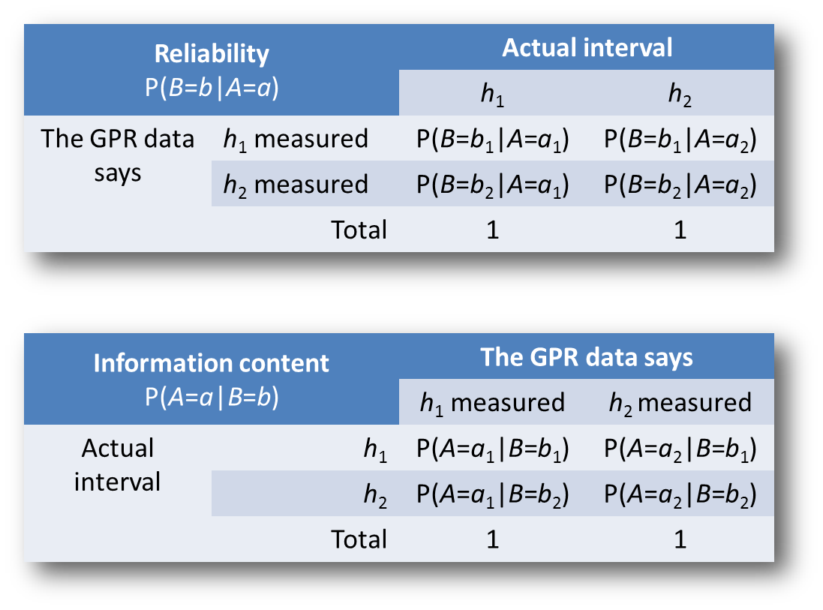
Data reliability vs information content

Slide 10
Bayes’ rule
Calculating information content from data reliability
Because (summing over all possibilities of A)

Slide 11
Decision tree with data
a1
NPV(a1)
P(A=a1)
A
a2
NPV(a2)
P(A2)
A=a1|b1
NPV(a1)
A
b1
A=a2|b1
NPV(a2)
B
A=a1|b2
NPV(a1)
A
b2
A=a2|b2
NPV(a2)

Slide 12
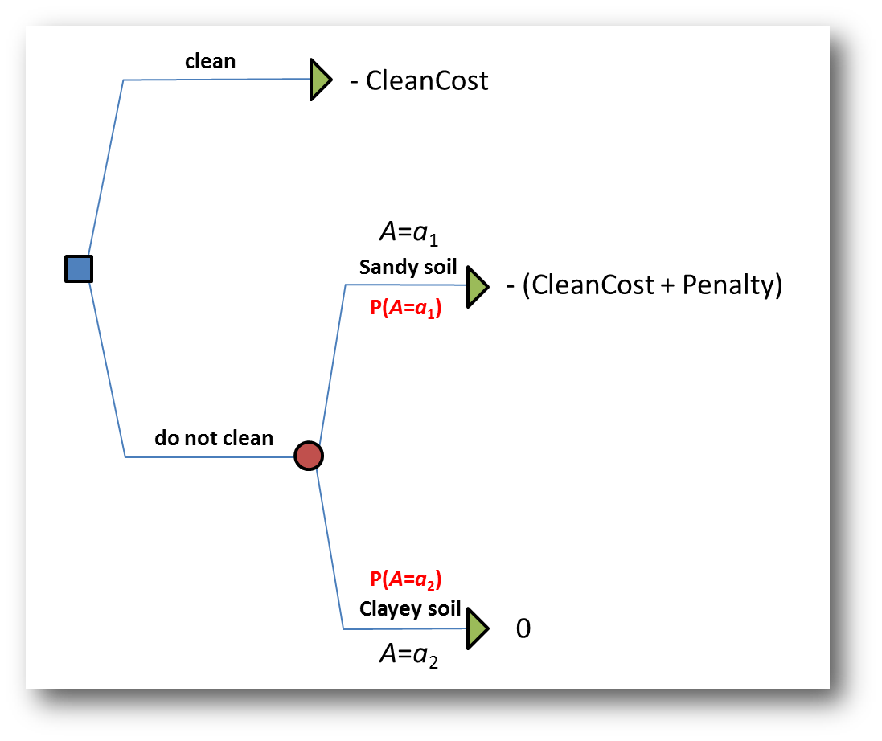
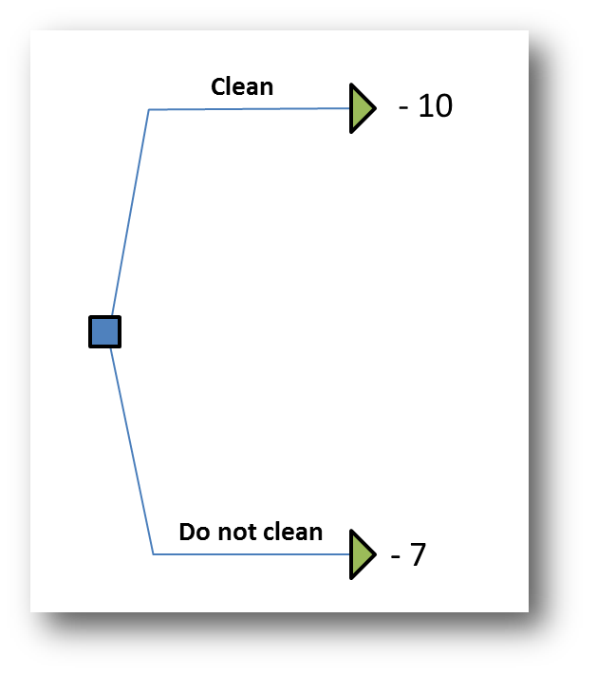
Example: decision problem
Cleancost = 10; Penalty = 7.5, P(A=a₁)=0.6; P(A=a₂)=0.4

Slide 13
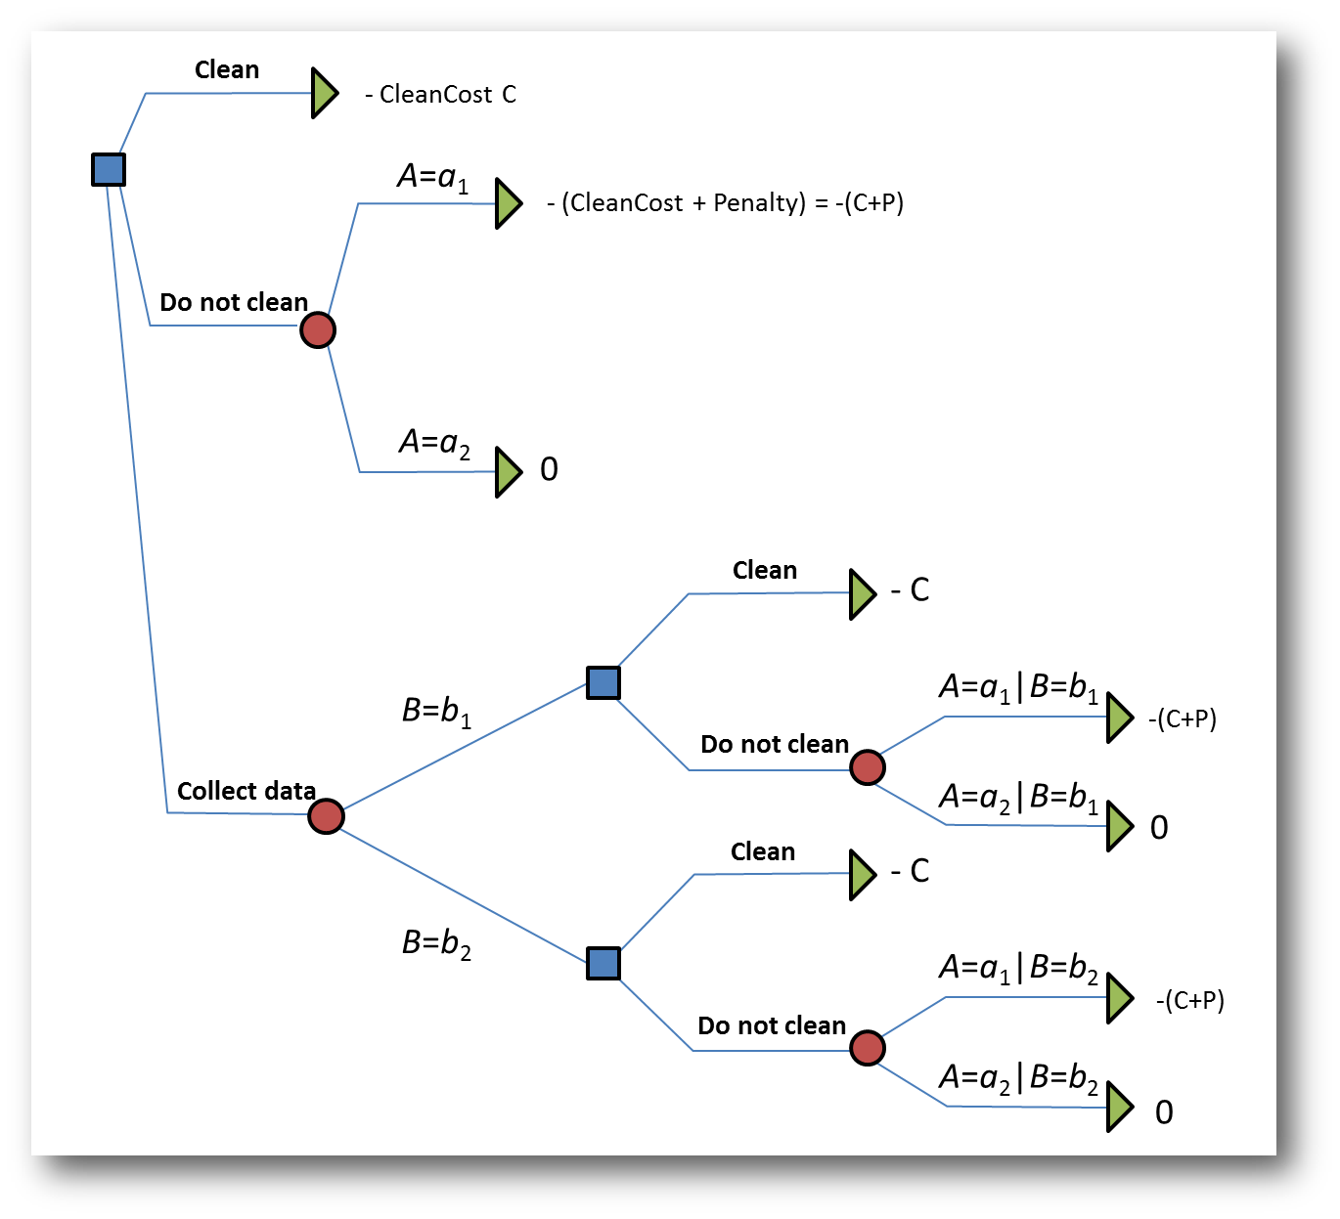
Decision with the option to collect data

Slide 14
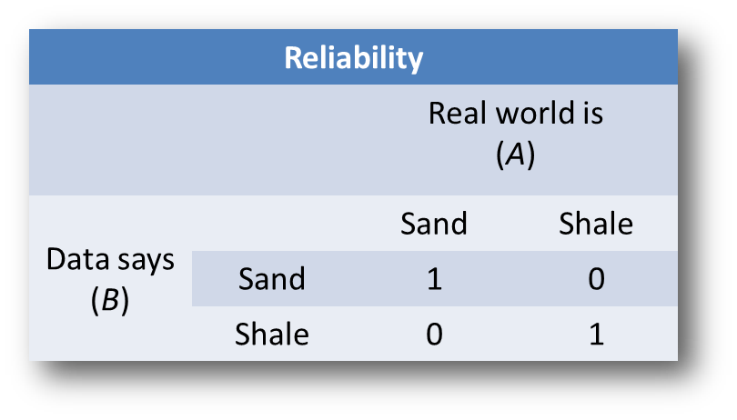
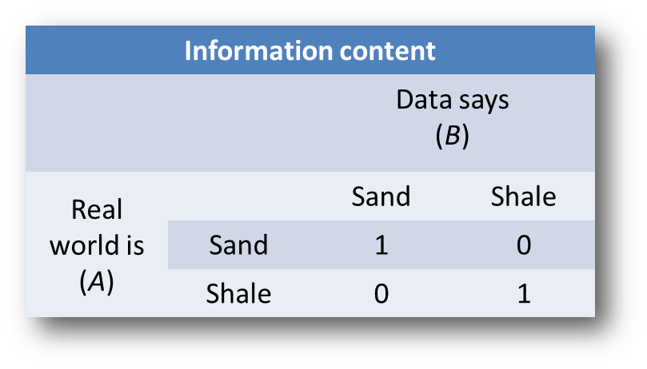
Perfect information

Slide 15
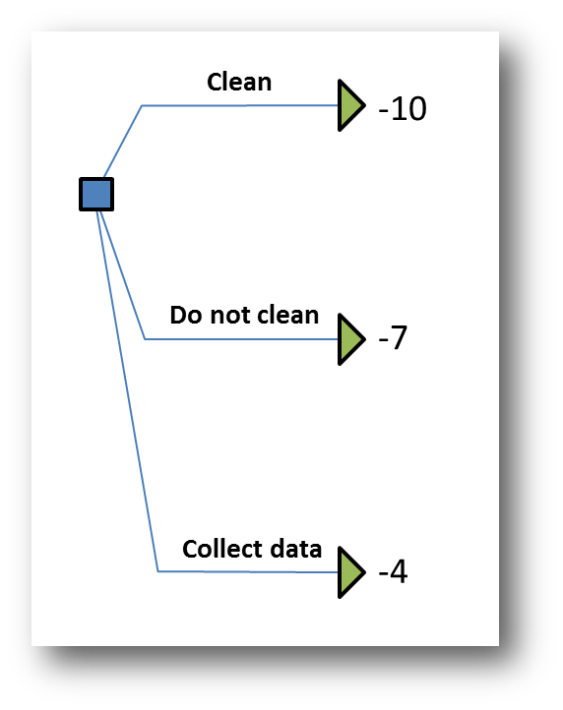
Result

Slide 16
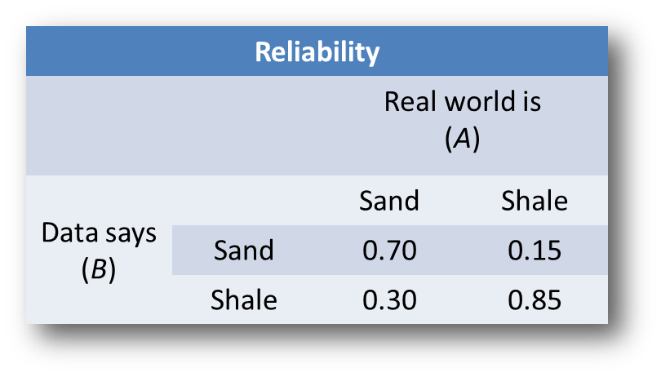
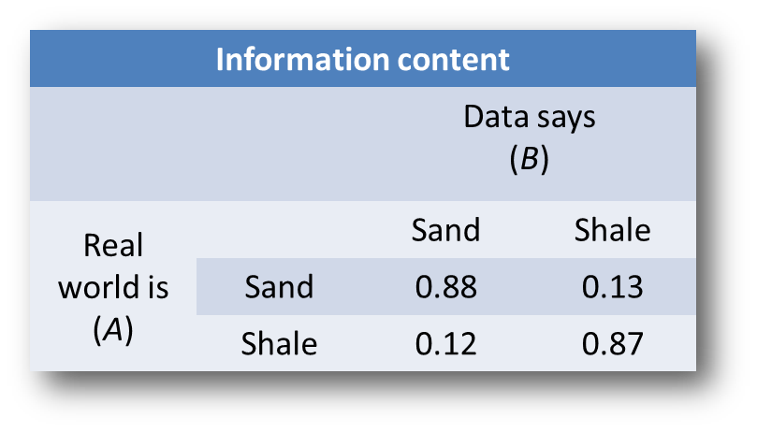
Imperfect data

Slide 17
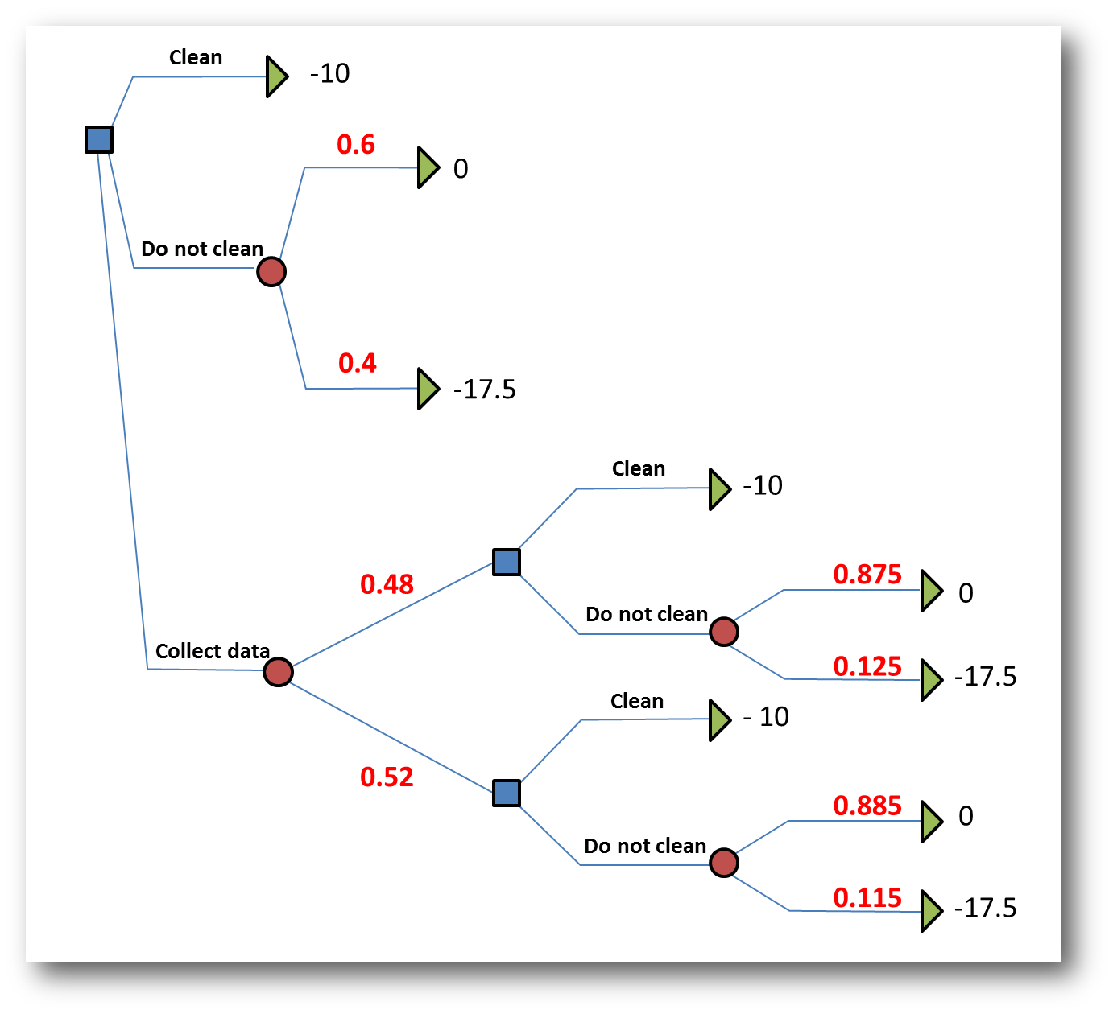
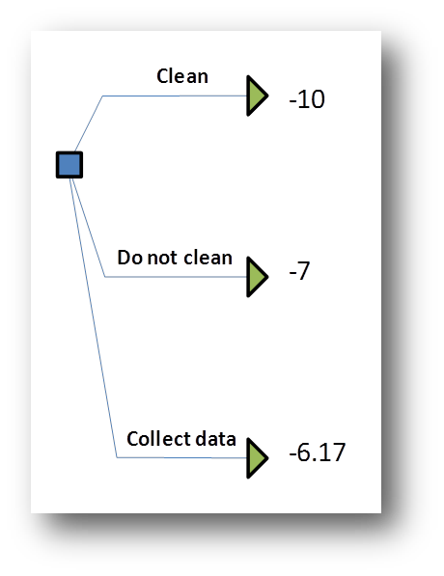
Result

Slide 18
Spatial value of information problems
Previously: the uncertain event was a simple binary or categorical variable
What if the “uncertain event” is the “uncertain Earth model”
What if the data is complex such as geophysical data

Slide 19
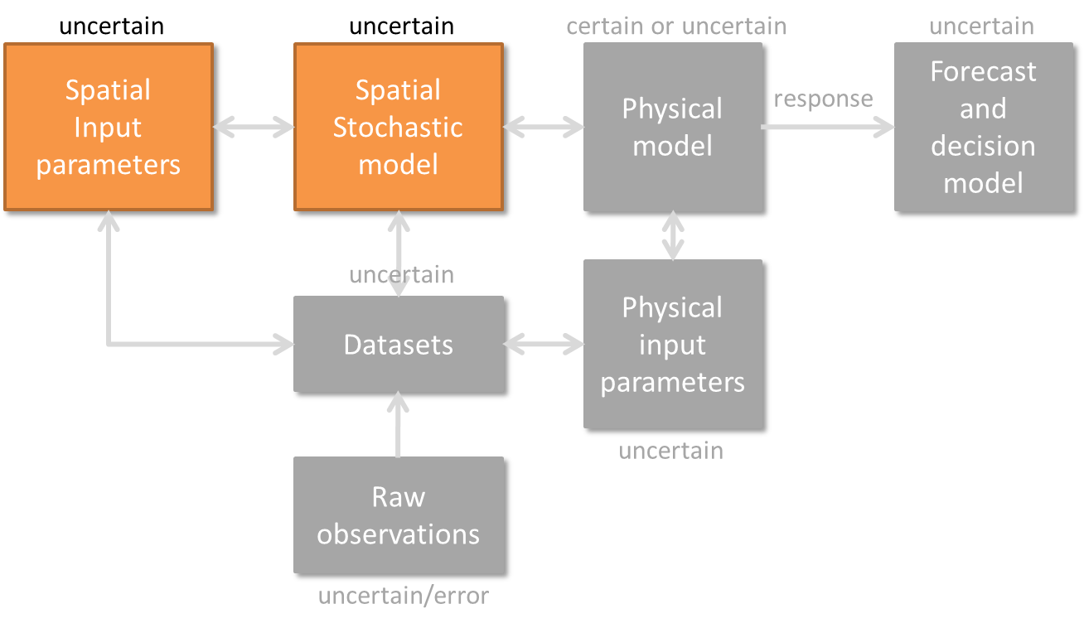
Two components in modeling spatial uncertainty

Slide 20
Example case study
Wells to extract groundwater
Farming area
Coast-line
Intrusion of sea-water due to excessive use
of groundwater for farming

Slide 21
Challenge
Intrusion of sea-water due to excessive farming
Intrusion is not “uniform”, areas which have subsurface fluvial channels have more intrusion
We don’t know exactly where channels are: uncertainty
We don’t know what the best action to take is

Slide 22
Alternative actions
Drill wells and inject water to replenish the groundwater table and drive out the salt water
Propose three location for such recharge = three different actions + no recharge
Loc 1
which is the best location
if we can only afford one well?
Loc 2
Loc 3

Slide 23
Recall
Earth Models
Seed 1
Seed 2
(input uncertainty)
Spatial
Stochastic
simulator
input
(spatial uncertainty)
Data
(samples, well, geophysics…)

Slide 24
Recall
Earth Models
Seed 1
Seed 2
(input uncertainty)
Spatial
Stochastic
simulator
input
(spatial uncertainty)
Data
(samples, well, geophysics…)

Slide 25
Formalization of VOI
Consider a case with one uncertain input parameter and with two possible choices for it
For example, you have two training images each with a certain prior probability and you generate Earth models with TI₁ and Earth models with TI₂

Slide 26
Formalizing the decision problem
Decisions are based on alternatives defined by taking different actions a (drill at A or drill at B or…)
Response functions g_{a} are used to predict the outcome of these actions (e.g. flow simulation) on Earth models

Slide 27
Formalizing the decision problem
Comparing alternatives is based on value: what is the value of the predicted action (what is the value of drilling at location A,B etc…)
Since Earth models are uncertain, value is uncertain, we take the expected value to make a decision

Slide 28
Formalizing the decision problem
which one has the maximum value ?
mathematically we write this as follows

Slide 29
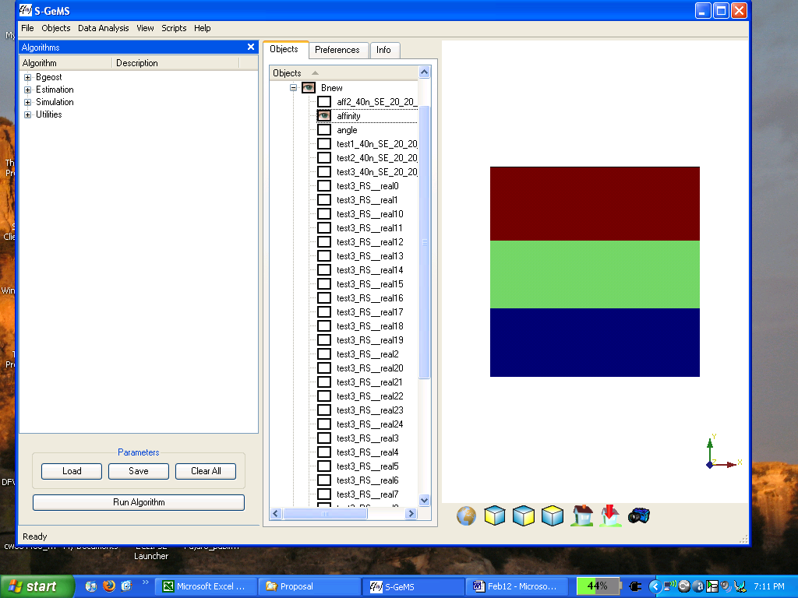
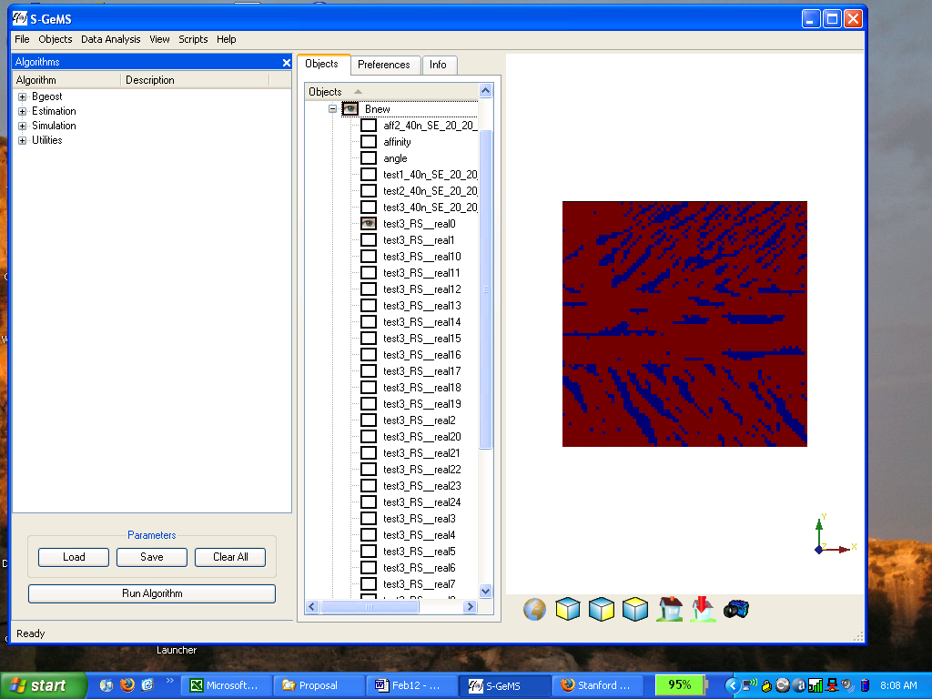
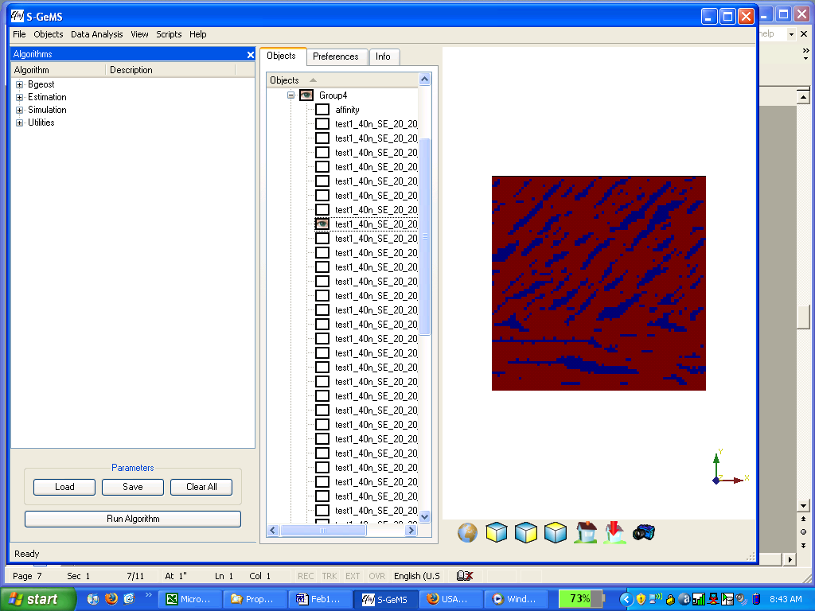
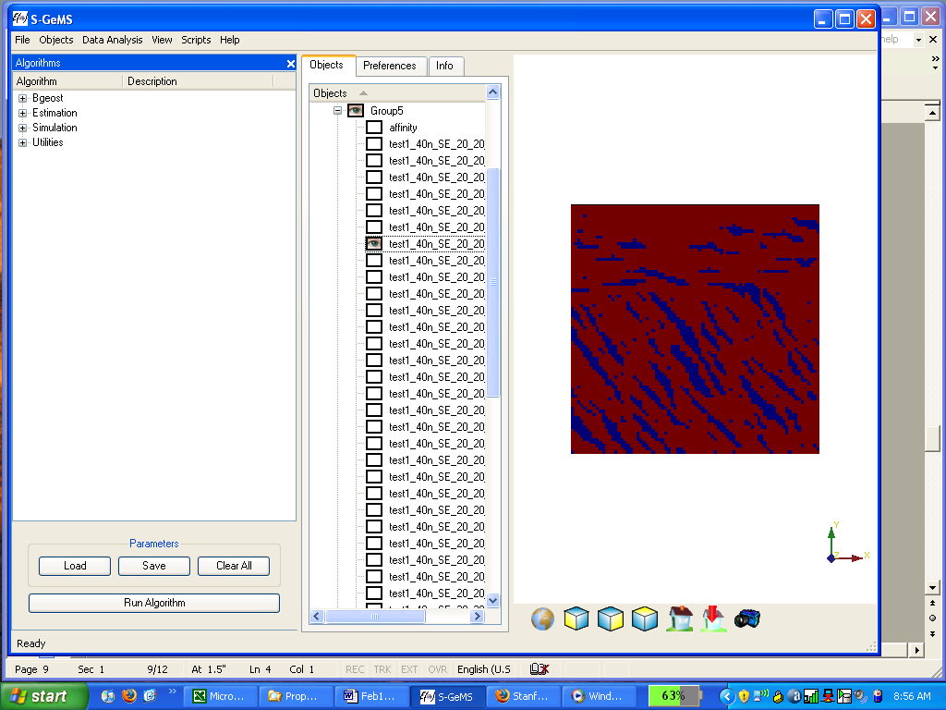
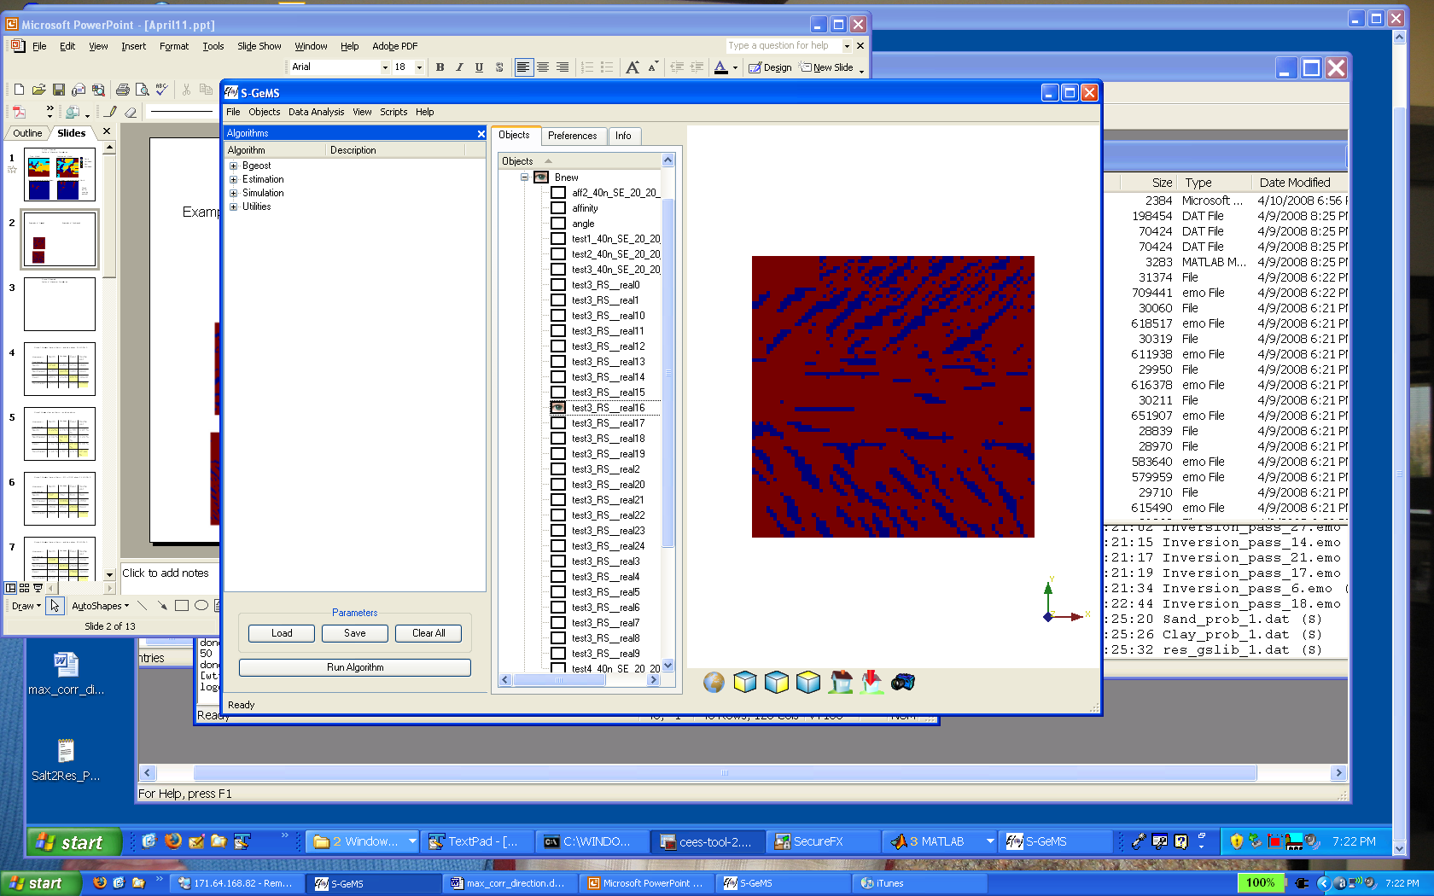

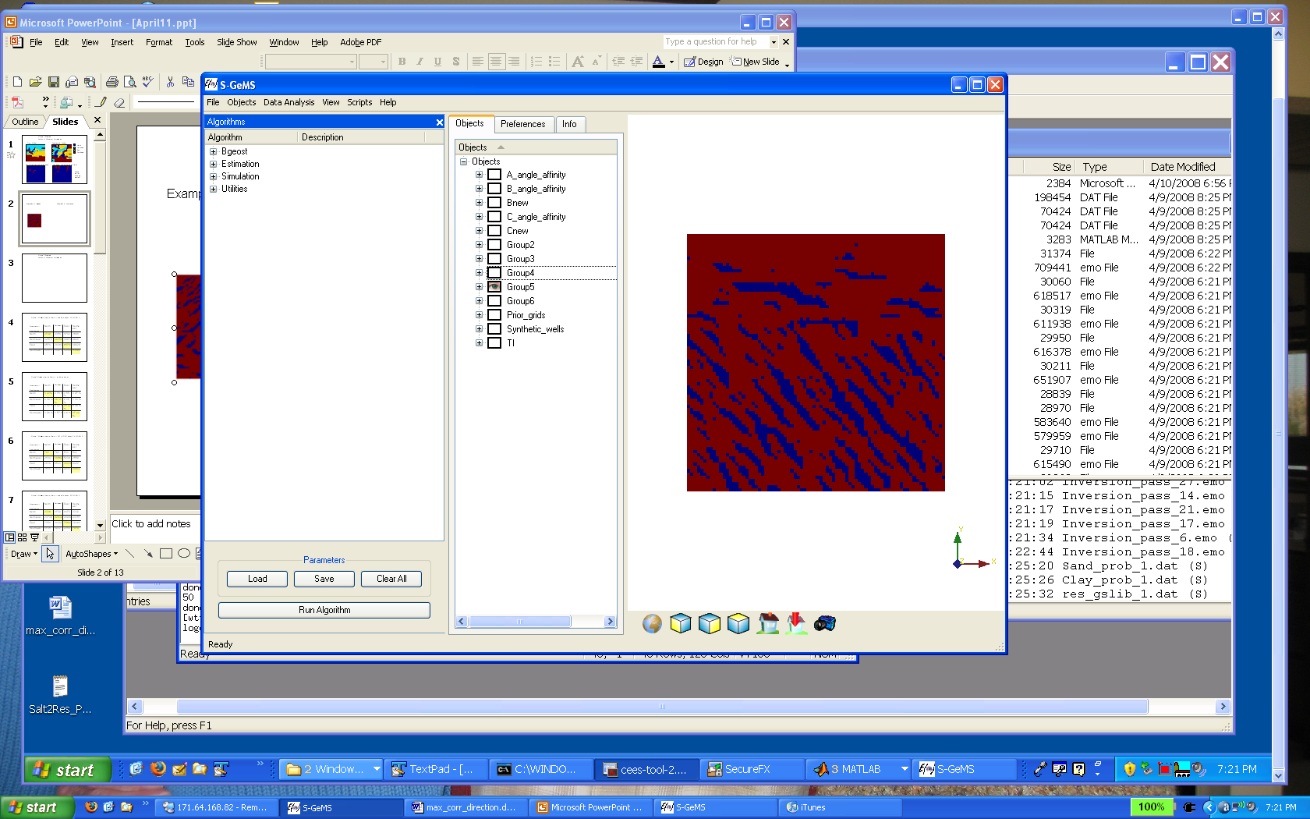
Case study: modeling uncertainty
θ₁
θ₂
θ₃
45º
- 45º
0º
Mixed
0º
Northwest
Southwest
45º
- 45º
- 45º
0º
45º

Slide 30
Definition of value
Salinity in the groundwater in an area will eliminate the potential of growing crops
A threshold is defined on salinity content of water in the subsurface and used to determine whether that area can yield crops
That yield gets equated in dollars
Most important: determining the salinity requires flow simulation

Slide 31
Alternative actions
Drill wells and inject water to replenish the groundwater table and drive out the salt water
Propose three location for such recharge = three different actions + no recharge
Loc 1
which is the best location
if we can only afford one well?
Loc 2
Loc 3

Slide 32
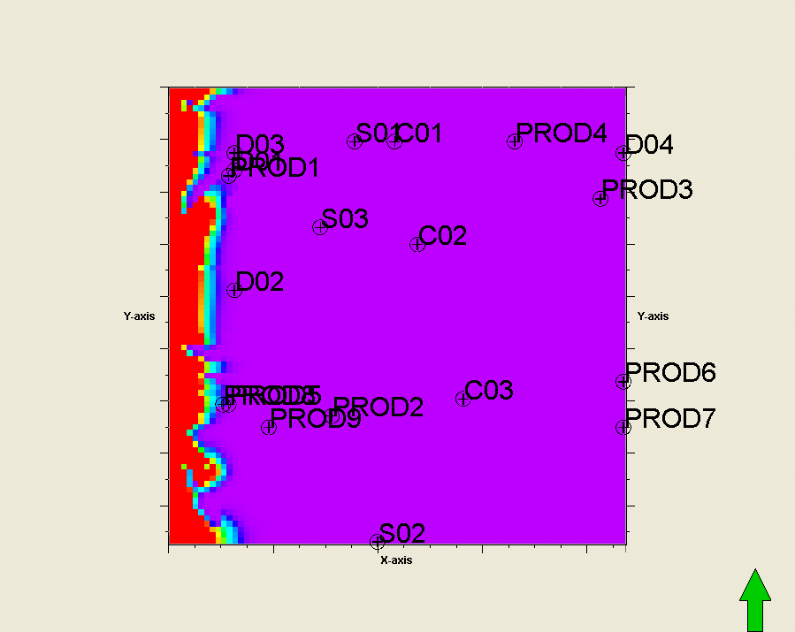
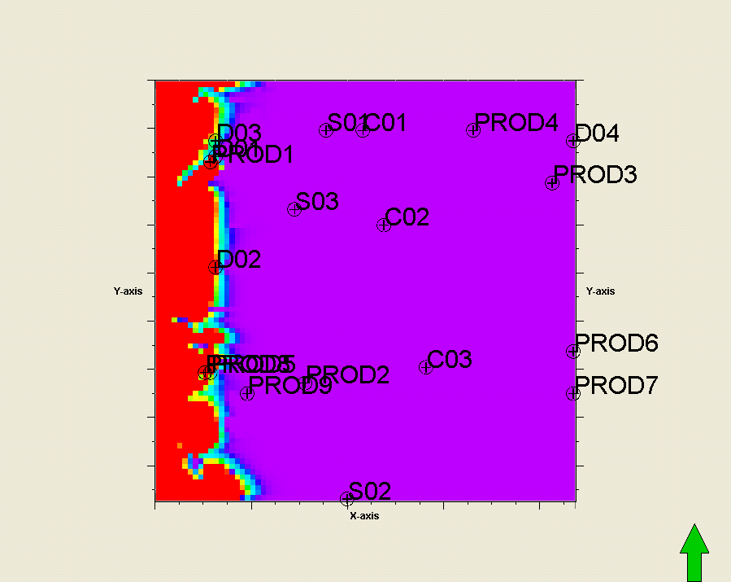
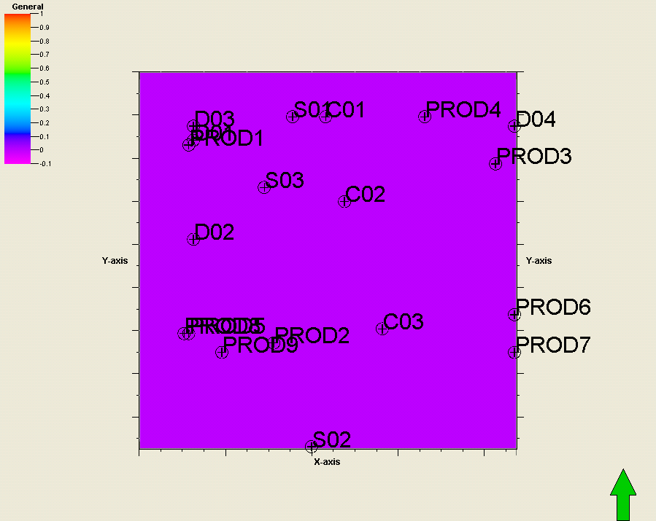
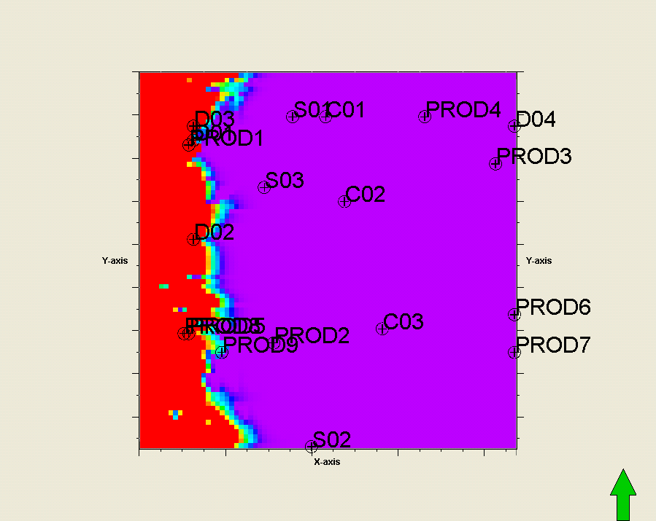
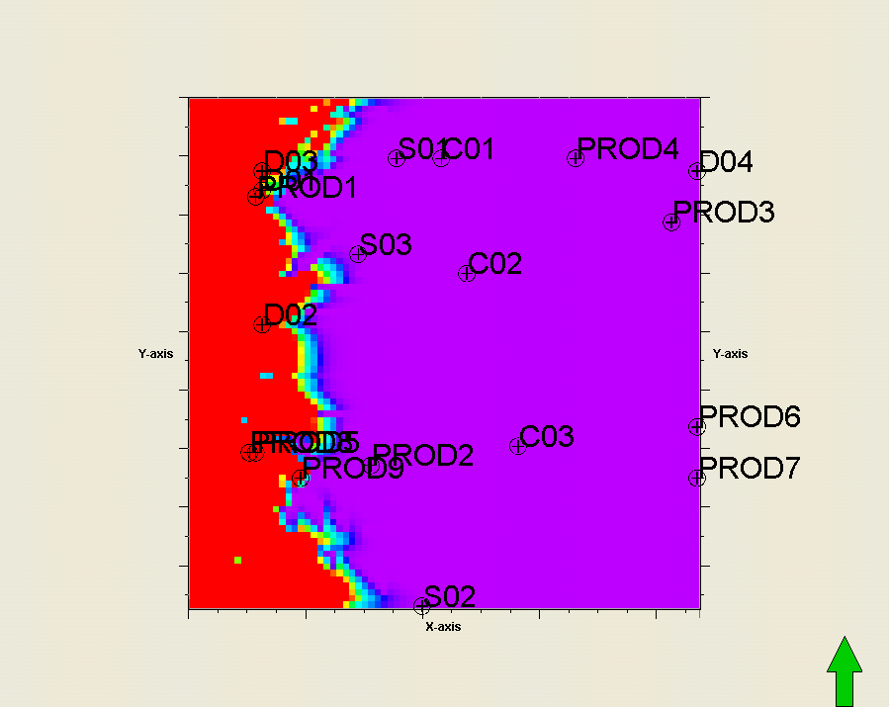
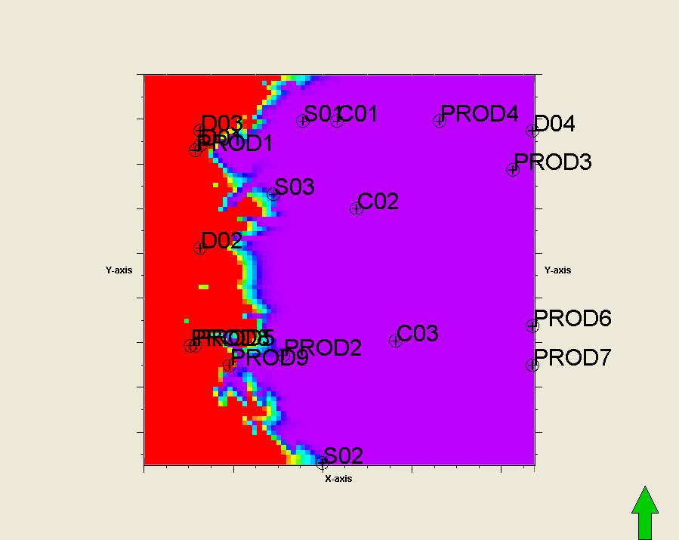
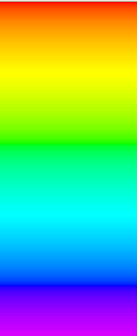
Flow simulation
salinity
Flow simulation with the existing pumping wells in this area

Slide 33
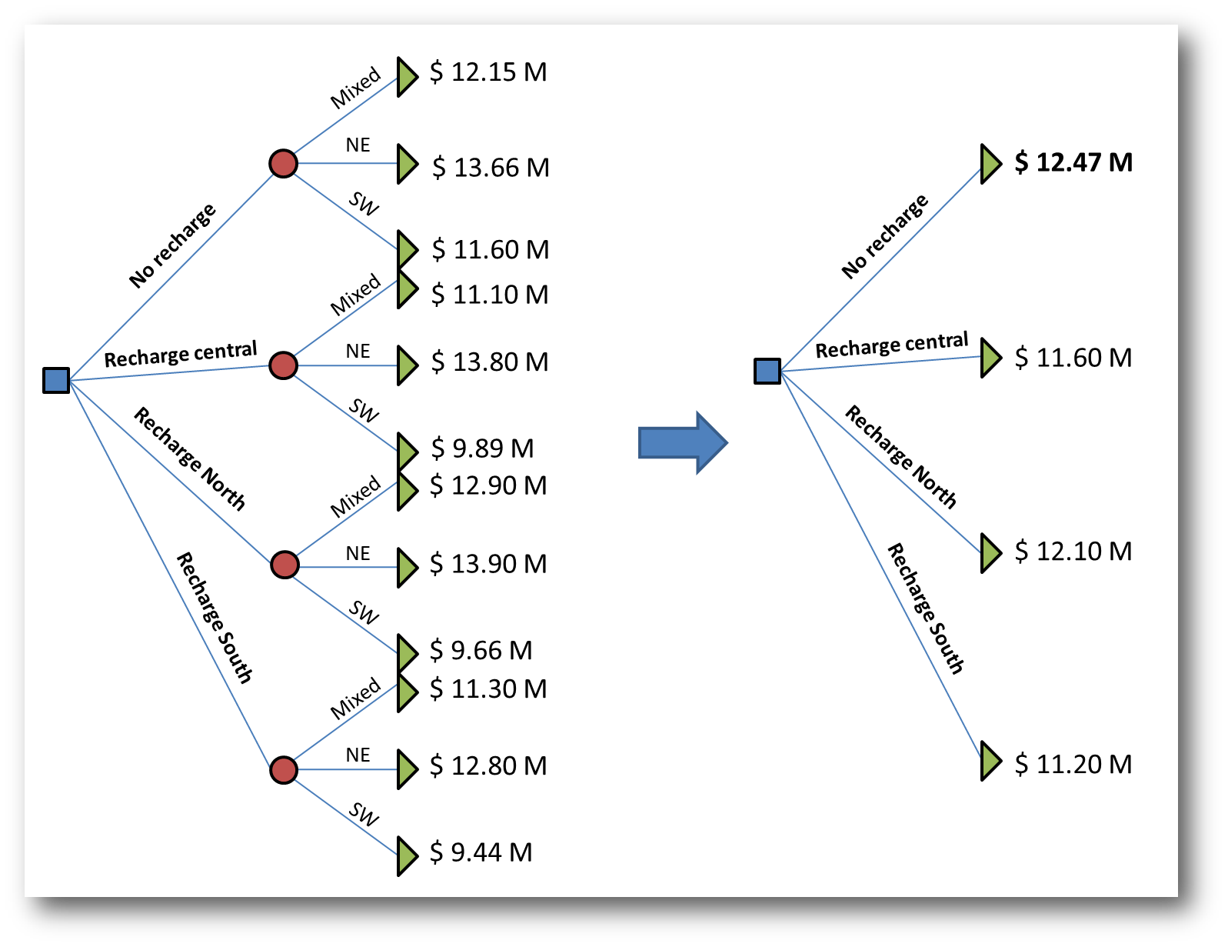
Decision tree without data

Slide 34
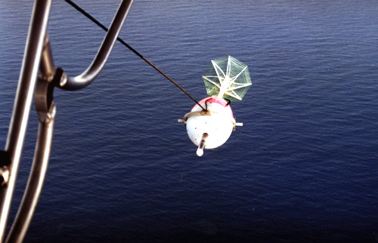
The data: airborne TEM
Electrical resistivity is an indicator of clay-content

Slide 35
Purpose of the data
Important : the data does not measure the “outcome of a decision”
The data measures an uncertain property of the Earth, in this case the uncertain parameter Θ, that will impact the outcome of a decision
How reliable is the data in determining this parameter → reliability

Slide 36
Reliability
Recall: reliability =
In this case

Slide 37
Reliability calculation
Step 1: generate Earth models by varying Θ (see above)
Step 2: on each Earth model, forward simulate the data
Step 3: on each forward simulation, interpret the data in terms of Θ
Step 4: compare that interpreted Θ with the original Θ of step 1, namely: do you get a match ?

Slide 38
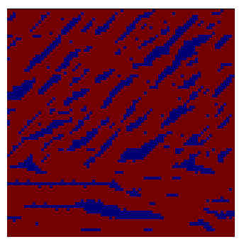
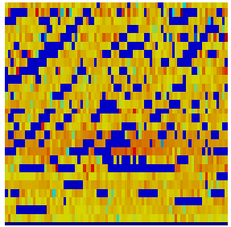
Step 2
Earth model
Forward simulated data
Geophysics
Forward simulation
θ₂
- 45º
Northwest
- 45º
0º

Slide 39
Step 3
Forward simulated data
S₂
- 45º
Make an
interpretation
Northwest
- 45º
0º
Did you get back θ₂ ?

Slide 40
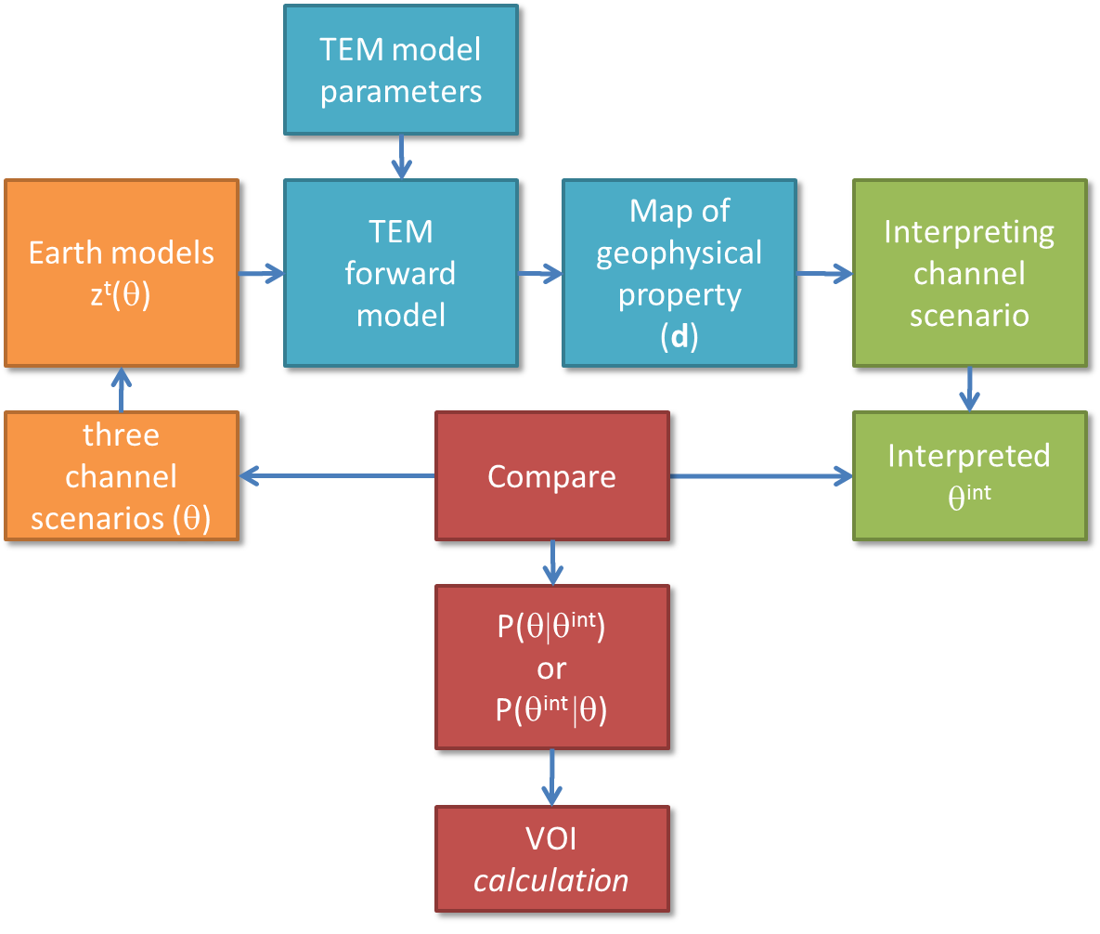
Workflow

Slide 41
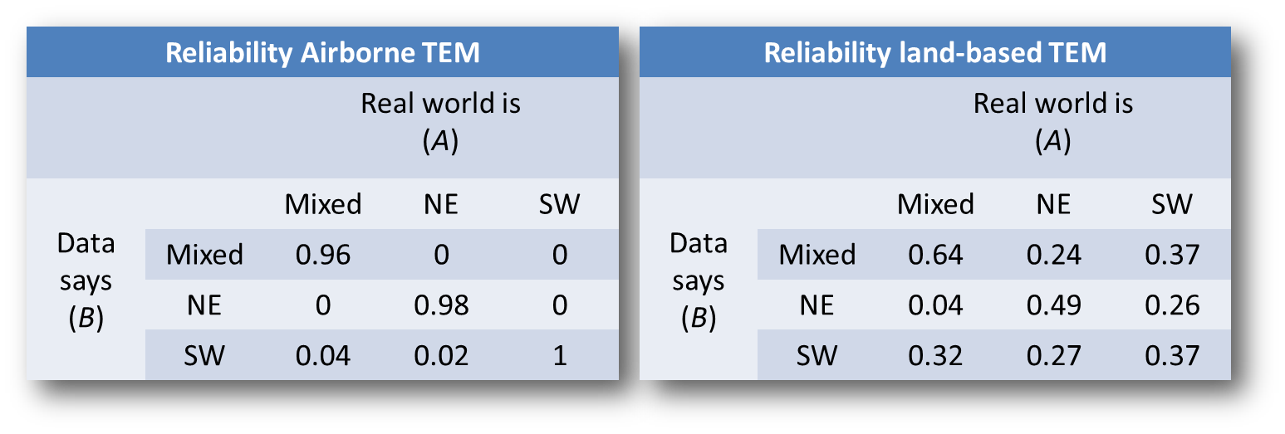
Step 4

